Slide 1


Industry Internship – Final Presentation On “Data Science Internship at Take It Smart”
Dept. of CS&E ( DATA SCIENCE)
Adichunchanagiri Institute of Technology
Chikkamagaluru - 577102
Presented By, Under the Guidance
Mohammed Shakir (4AI22CD036) Prof. Shilpa K V

Slide 2
CONTENTS
Introduction
Objectives of the Internship
Learning Experiences
Learning Outcomes
Internship Work Summary
Project Outputs

Slide 3
INTRODUCTION
About the Organization
Take It Smart (OPC) Pvt Ltd is a technology-driven company specializing in innovative solutions in the fields of Data Science, Artificial Intelligence, Machine Learning, and software development. The organization focuses on providing industry-oriented internship programs that combine theoretical concepts with practical implementation, helping students gain real-world technical experience.
Key Highlights of the Organization
Hands-on learning approach
Exposure to AI/ML tools and frameworks
Dashboard and web application development
Real-time datasets and projects

Slide 4
OBJECTIVES OF INTERNSHIP
Technical Objectives
To learn Python programming and Object-Oriented Programming (OOP) concepts.
To understand the Data Science and Machine Learning lifecycle.
To work with libraries such as NumPy, Pandas, Matplotlib, and Seaborn.
To develop dashboards using Power BI.
To understand Deep Learning and Natural Language Processing (NLP) concepts.
To learn Generative AI, Retrieval-Augmented Generation (RAG), Vector Databases, and LLM frameworks.

Slide 5
Practical and Professional Objectives
To gain hands-on experience in real-time projects.
To improve problem-solving and analytical thinking skills
To work with real-world datasets and practical applications.
To improve communication and presentation abilities.
To understand industry workflow and deployment processes.

Slide 6
LEARNING EXPERIENCES
Technical Learning
During the internship, I gained exposure to different tools and technologies used in Data Science.
Learned Python for data analysis.
Used SQL for database operations.
Created dashboards using Power BI.
Worked with Pandas and NumPy.
Learned EDA and Machine Learning using Scikit-learn

Slide 7
Practical Implementation
Data Analysis and Preprocessing using Python, NumPy, and Pandas
Data Visualization using Matplotlib, Seaborn , and Plotly
Dashboard Development using Power BI
Machine Learning and Deep Learning Model Implementation
NLP and Generative AI Application Development using RAG

Slide 8
Project Experience
Developed Machine Learning and Data Science based applications.
Worked on real-world datasets for analysis and prediction tasks.
Built interactive dashboards and data visualization projects.
Implemented NLP and Generative AI based solutions using RAG architecture.
Gained practical experience in project deployment and workflow management.

Slide 9
Challenges
Understanding complex Machine Learning and AI concepts.
Working with real-world datasets and data preprocessing.
Managing errors and debugging during project development
Optimizing model performance and project workflow.
Learning new tools and technologies within limited time.

Slide 10
Project Overview
Worked on Data Science, Machine Learning, and Generative AI based projects.
Developed dashboards using Power BI and visualization libraries.
Performed data preprocessing, analysis , and visualization on real-world datasets.
Implemented Machine Learning, Deep Learning, and NLP techniques.
Built AI application using LangChain and RAG architecture.

Slide 11
LEARNING OUTCOMES
Technical Learning Outcomes
Gained strong understanding of Data Science concepts
Learned Machine Learning workflows and model development
Developed dashboards using Power BI
Gained practical exposure to NLP and Transformer models
Learned Generative AI and RAG-based systems

Slide 12
Practical Learning Outcomes
Worked with structured and unstructured datasets
Improved data visualization and analytical skills
Performed Exploratory Data Analysis (EDA) and KPI analysis
Implemented Machine Learning models practically
Gained deployment experience using Streamlit

Slide 13
Professional and Personal development
Improved communication and presentation skills
Enhanced problem-solving and analytical abilities
Improved time management and work discipline
Developed professional work ethics and responsibility
Gained industry exposure and practical understanding of workflow

Slide 14
INTERNSHIP WORK SUMMARY
Weeks 1–5: Foundations & Data Analysis
Python Fundamentals and OOP Concepts
NumPy and Pandas
Statistics and Probability
Data Visualization
SQL and Database Management
Restaurant Sales Analysis Project
Weeks 6–8: Machine Learning & Dashboarding
Power BI Dashboard Development
Pizza Sales Analysis Project
Machine Learning Fundamentals
Regression and Classification Models

Slide 15
INTERNSHIP WORK SUMMARY
Weeks 9–14: Advanced AI & Generative AI
Deep Learning using TensorFlow
NLP and Transformer Models
Computer Vision Concepts
Generative AI and RAG Architecture
Vector Databases and LangChain
Chatbot Development
Amazon Bedrock and AI Agents

Slide 16
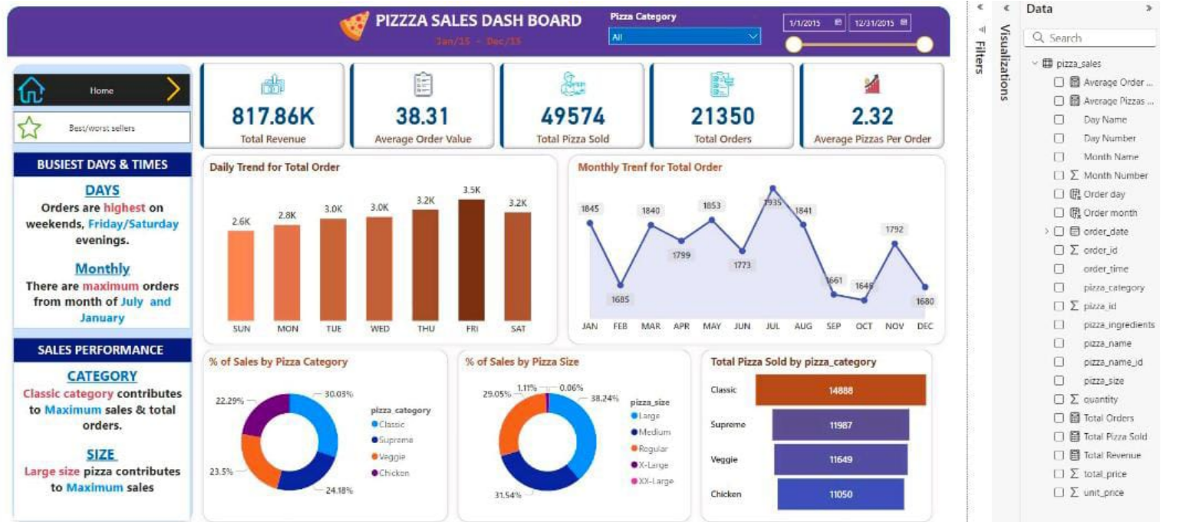
PROJECT OUTPUTS
Pizza Sales Analysis Dashboard
Built an interactive Power BI dashboard to analyze pizza sales, track revenue trends, and identify customer preferences and top-selling pizzas. Used SQL and Python for data processing and KPI analysis with interactive visualizations.
Fig 1:Pizza sales analysis dashboard

Slide 17
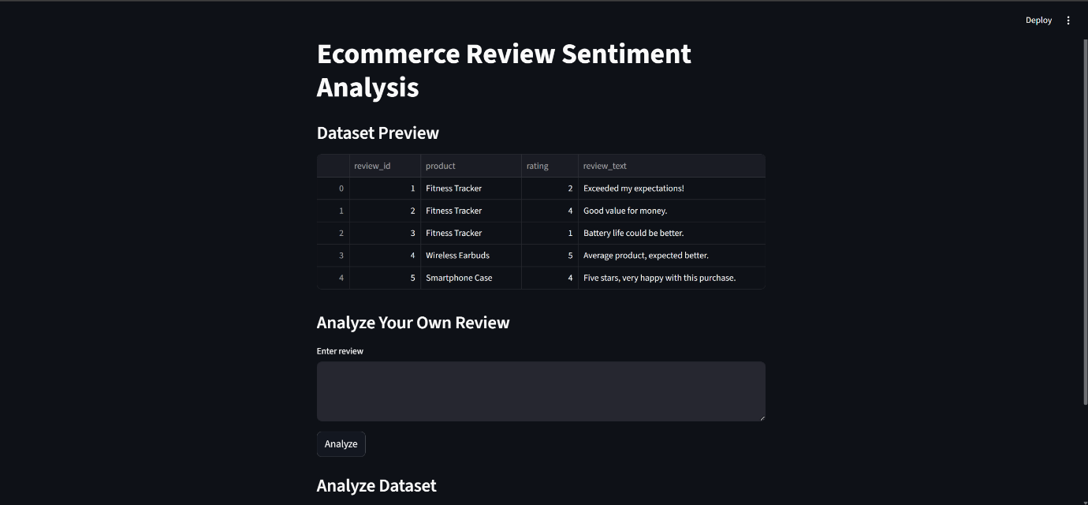
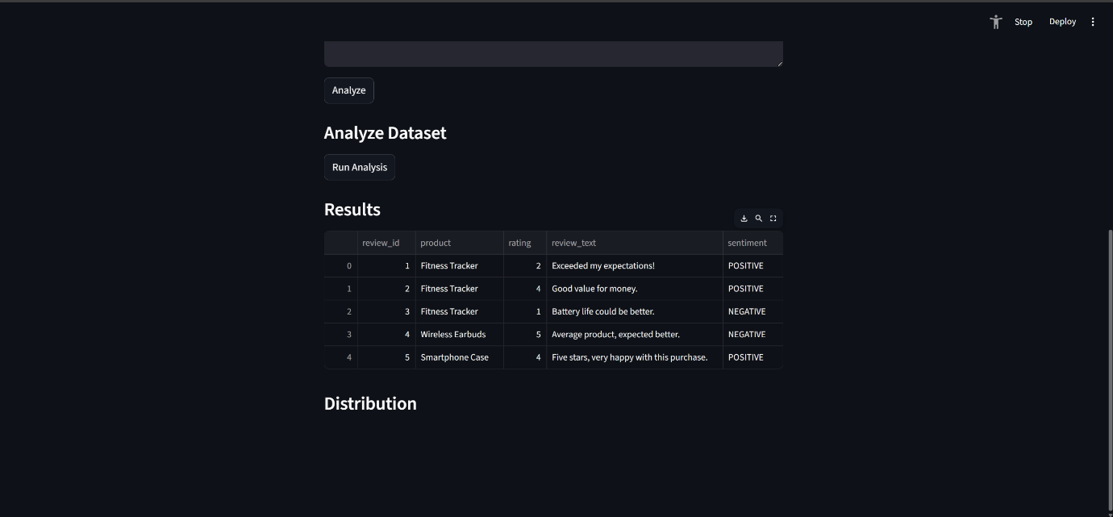
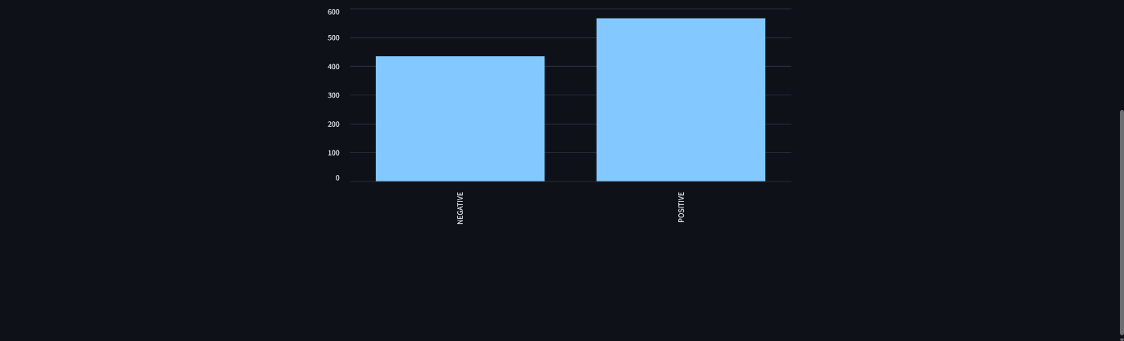
Ecommerce Review Sentiment Analysis
Built an interactive Streamlit-based sentiment analysis system for ecommerce reviews using Python and DistilBERT. The project analyzes customer feedback, predicts positive or negative sentiment with confidence scores, and visualizes insights through interactive charts and dashboards.
Fig 2:Input Interface
Fig 3:Prediction result

Slide 18
Thank You

